Slide 1

Leveraging Data Science for Growth: H&M
Group 8
SYDNEY NG DENG JUN
BHAIRAVI VAIRAVELU
DAI YU
WIDYA TANTIYA YUTIKA
YIN HANG
Notes:
Original title: Personalized Product Recommendation System for H&M
Hello there,
Today, Group 8 will be presenting how we can leverage data science for growth for the retail giant known as H&M. Our group members are Sydney, Bhai, Dai Yu, Widya and Yin Hang.

Slide 2
Contents
Background
Problem Statement
Objectives
Dataset
Exploratory Analysis
RFM Analysis
Market Basket Analysis
Recommender System
Data Governance
Conclusion
Notes:
The contents we will cover today is the background on H&M, the problem statement and objectives of our project as well as the dataset we will be using and the exploratory analysis conducted by team. We will also cover the analysis carried out by the team, this includes the RFM Analysis, Market Basket Analysis and the Recommender System built by the team. Finally, we will sum up our presentation with the conclusion.

Slide 3
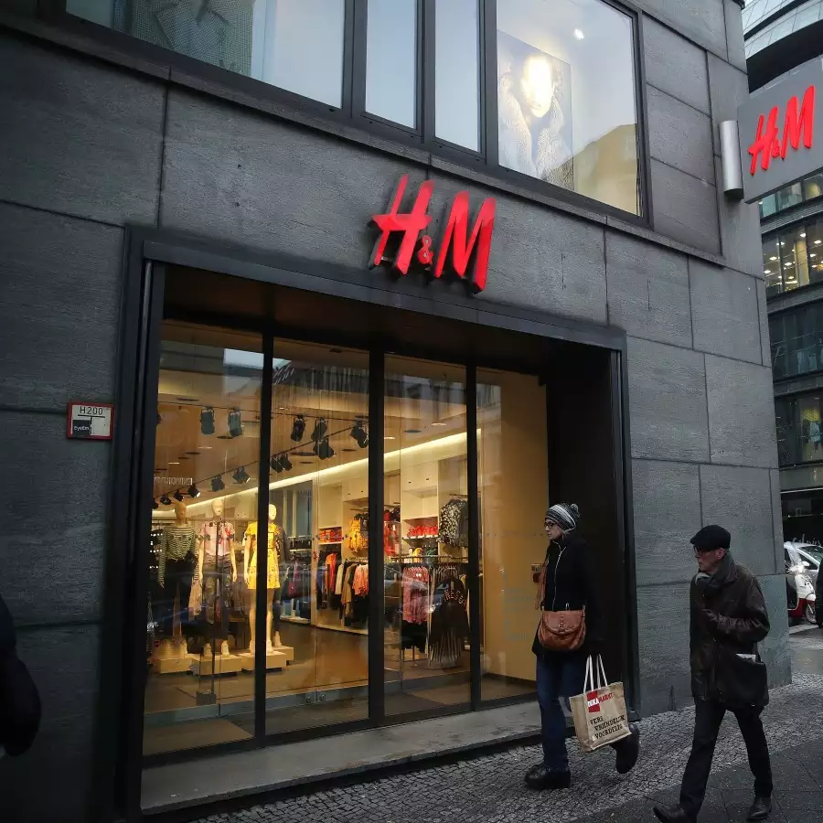
Background - H&M
Leading global fashion retailer
Strong presence in industry
Valuable apparel brand
Notes:
First, let’s have a quick background on H&M; H&M is a multinational clothing company based in Sweden that focuses on fast-fashion clothing. It is a leading global fashion retailer that has a strong presence in the apparel industry. It was also ranked among the world’s top 10 most valuable apparel brands in 2022. As of Nov 2022, H&M has more than 4000 stores worldwide and employs more than 100,000 people.

Slide 4
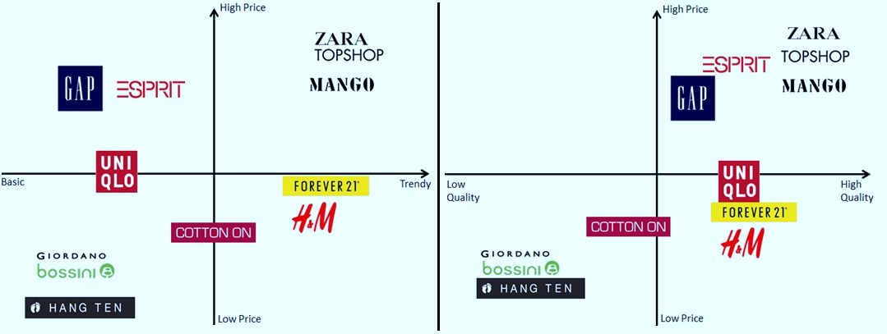
Problem Statement
Highly competitive market
Aims to
Increase sales
Drive growth
Target customers more effectively
Leverage data science concepts
Notes:
The retail industry is highly competitive market. H&M has managed to stay relevant and in demand as it has high quality and trendy products for a low cost, as shown by the quadrants on our slide. However, despite its success, H&M has been facing several challenges. One of the significant challenges faced by H&M is increasing its sales and driving growth. In order to strive in the growingly competitive retail industry, H&M must target customers more effectively by leveraging data science concepts to improve their revenue and boost transactions.

Slide 5

Objectives
Perform RFM analysis to gain insights into customer behaviors
Conduct Market Basket Analysis to identify cross-selling opportunities
Develop Product Recommendation System to promote specific products
Notes:
Based on the challenges faced by H&M, our team has proposed the following solutions. There are three main objectives for this project. First, we want to perform RFM analysis to gain insights into customer behaviour patterns and preferences, which will then allow H&M to effectively target their customers. Next, we want to conduct a market basket analysis to identify cross-selling opportunities for H&M so that they will be able to maximize their sales from targeted customers. Finally, we want to develop a personalized product recommendation system based on the combined analysis of customer behaviours and product strategy to enable H&M to promote specific products to their customers, which will help to boost their quantity and volume of sales. Overall, these objectives aim to improve the customer engagement and loyalty, and ultimately drive sales growth for H&M.

Slide 6

Data Source & Exploratory Analysis
Notes:
I’ll continue with the Data Source and Exploratory Analysis of the datasets

Slide 7
Data Source
H&M purchase history of customers across time data from kaggle.com:
Articles (article ID, product name, product group section name, product patterns, product colors, index group)
Customer (customer ID, Member status, news frequency, age)
Transaction Train (date, customer ID, article ID, price, sales channel ID)
Notes:
For our project, we are using 3 H&M datasets obtained from Kaggle.com
The first dataset: article dataset includes products available for purchase in H&M and their detailed information such as article name, section name, colour, graphical appearance, garment type.
The second dataset: customer dataset includes customer detailed information such as customer ID, member status, news frequency, age
The last dataset: transaction dataset consists of the purchases done by each customer from Sep 2018 to Sep 2020.
It includes the date of transaction, customer ID, articles ID, price, and sales Channel ID.
The datasets are considered cleaned but

Slide 8
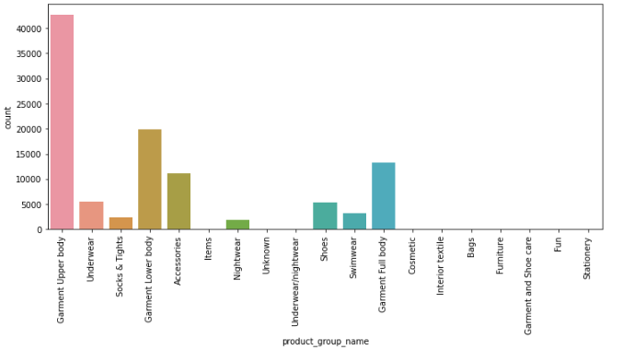
Data Exploratory: Article Dataset
As of Sept 2020, H&M has a total of 105,542 items available for purchase and varies along 19 product group name
The majority of the items are garment upper body and garment lower body.
Notes:
Next, I will continue with data exploratory on article datasets
As of Sept 2020, H&M has more than 100 thousands products available for purchase and varies along 19 product group name as shown in the bar chart
The majority of the products are garment upper body, followed by garment lower body.

Slide 9
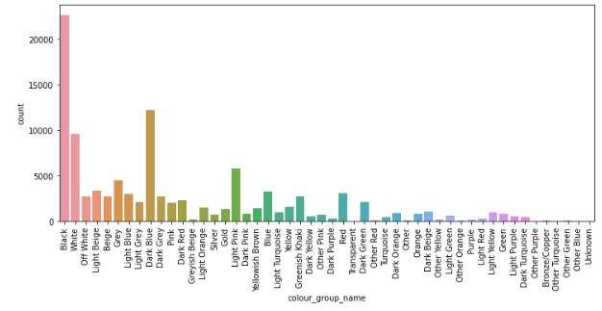
Data Exploratory: Article Dataset
A total of 50 color variations
Most of the products are black color, followed by dark blue and white
Notes:
Among all the products, there are a total of 50 variation of colors.
Most of the products are black color, followed by dark blue and white.
About 30% of all items are monochrome (black and white) which are the basic color.

Slide 10
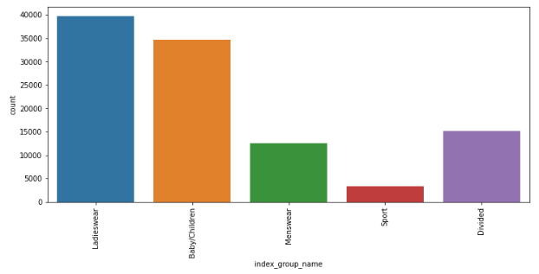
Data Exploratory: Article Dataset
H&M product range from ladieswear, menswear, baby/children, sportwear and divided
Ladieswear has the most products while sport has the least products.
Notes:
H&M product range from ladieswear, menswear, baby/children, sportwear and divided
Divided is aimed for teenagers with fun and young design.
H&M’s story begins in1947 when the founder opens the first store in Sweden, selling women’s clothing.
As ladieswear is the oldest fashion line of H&M history, that is why there are more ladieswear products compared to others.
And sportwear is their latest section launched in 2014 with least number of products as per the bar chart

Slide 11
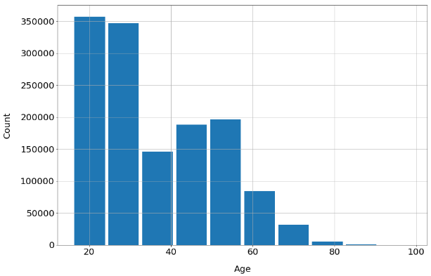
Data Exploratory: Customer Dataset
The customers range from 16 – 99 years old.
And mostly are within 20 to 30 years old.
Notes:
Next, I will continue with data exploratory on customer datasets
This is the age distribution of our customers datasets.
The customers range from 16 – 99 years old.
And mostly are within 20 to 30 years old.
Since there a lot of missing data for age, we do not further use it for our next analysis.

Slide 12
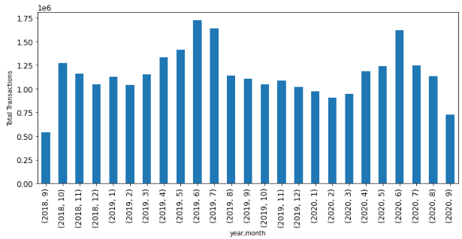
Data Exploratory: Transaction Dataset
Peak month is from May to July while the non-peak month is from Dec to Mar
Notes:
I will continue with our transactions dataset.
The graph here shows the monthly number of transactions from Sept 2018 to Sept 2020.
As shown from the graph, Jan Feb and March shows the lowest transaction and it is consistent in both 2019 and 2020.
Meanwhile, May, June and July has the highest transaction.
Understanding the transaction trend is important so H&M can decide when to do more marketing campaign which is during the non-peak season Dec-Mar
Overall, the sales fluctuate and do not seem to increase, so H&M need to come up with new strategies to further boost the sales
Based on this visualization, we decided that transaction will be much helpful for H&M ????

Slide 13
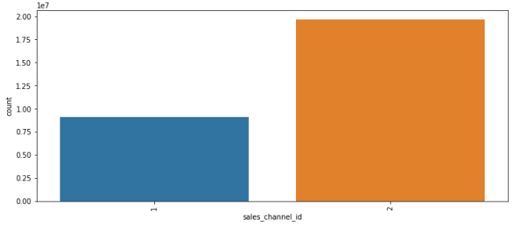
Data Exploration: Transaction Dataset
Offline transaction is more than twice as much as online transaction
Focus on improving online sales
Online
Offline
Notes:
The transactions are categorized into 2 group : online and offline
As we can see from the bar char, offline transaction is doubled as compared to online transaction.
Therefore, in our next analysis we will focus on improving the online sales.

Slide 14
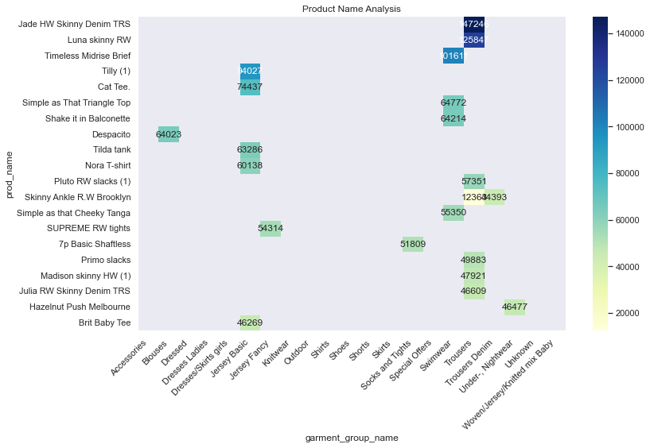
Data Exploratory: Combined Dataset
Jade HW Skinny Denim Jeans was the most popular products with more than 140,000 purchases
7 of top 20 products are trousers
Notes:
We also conducted the data exploratory on the combined datasets.
Here is the top 20 purchase grouped by the product name and garment type.
Overall, Jade HW Skinny Denim Jeans was the most popular items bought by customers with more than 140 thousands purchases within 2 years
And within the top 20 items, 7 of them are trousers and 5 of the are jersey basic.

Slide 15

RFM ANALYSIS
Notes:
Next, I'll be presenting the RFM analysis
RFM analysis is a common technique used to analyze customer behavior and divide them into different segments based on their buying patterns.
We segment customers In order to better understand our customers base in H&M and this will be used in our recommender system later.

Slide 16
RFM Analysis
FREQUENCY
MONETARY
RECENCY
How recent is the last purchase
The number of customer's transaction
Total value of the transactions
Customer
customer ID
Transaction Train
customer ID
article ID
prices
Dataset Utilization
Notes:
RFM analysis calculates the Recency, Frequency, and Monetary metrics for each customer using their transaction data.
Recency refers to how recent is a customer’s last purchase; frequency refers to the number of transactions of a customer; monetary refers to total values of transactions
The dataset used for RFM analysis is the combined data of customer and transaction train datasets. They are combined with reference to customer ID column.

Slide 17
RECENCY
Customer’s latest transaction date compared to dataset end date + 1
Percentile based on
Each Matrix
FREQUENCY
Number of transactions made by each customer
Combined
RFM Score
MONETARY
Adding up the total amount spent by each customer
Notes:
Then We build our RFM metrics in python.
Recency is calculated by subtracting the Customer’s latest transaction date compared to dataset end date + 1. when there are multiple transactions made by one customer, we will only take their last transaction.
Frequency is calculated by counting the number of transactions made by each customer,
and Monetary is calculated by adding up the total amount spent by each customer.
Then, we Assign R, F, and M scores based on quantiles or percentiles
Lower Recency values receive higher R scores
Higher Frequency and Monetary values receive higher F scores and M scores
Then Combine individual scores and calculate the total RFM score for each customer

Slide 18
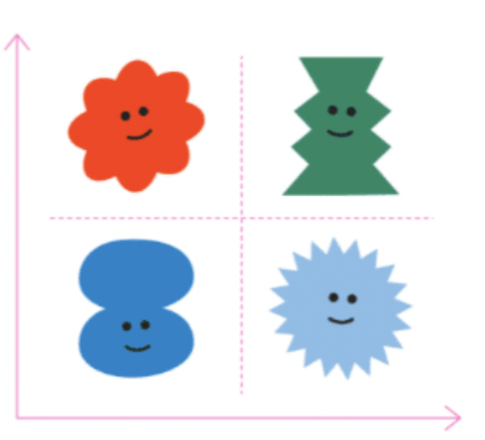

Customer Segmentation
Monetary $$
ALL Customers
HIGH VALUE
CHAMPION
RFM Score
Quantile
Segmentation
LOW VALUE
PROMISING
Frequency
Notes:
Finally, the RFM score is used to segment all the customers into four categories: champion, high value, promising and low value.
This is done using quantile-based segmentation.
We define quantiles and assign scores based on the quantiles for Recency, Frequency, and Monetary values. Then we group based on their combined RFM scores.
By segmenting customers based on their buying patterns, we can better understand them and tailor strategies to meet their needs.

Slide 19
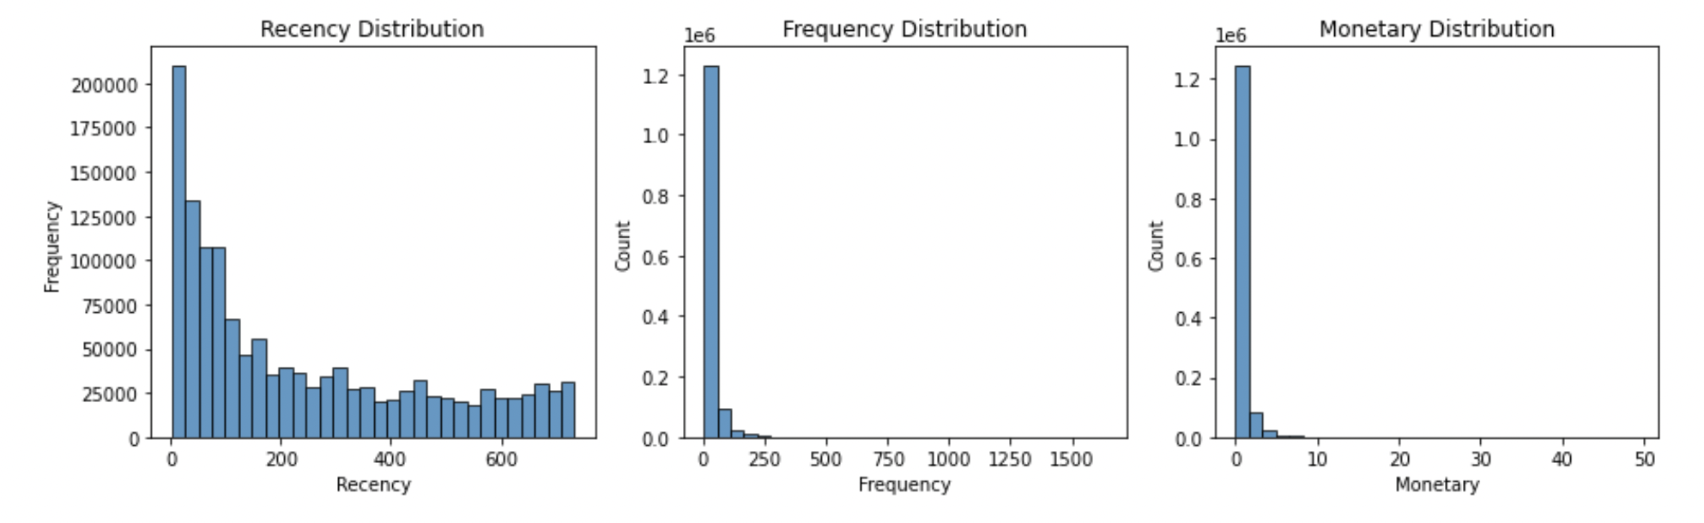

RFM Visualization
Notes:
We have built a visualization for individual score to understand our customer base.
We can see that major purchase skewed to the left for frequency and monetary.

Slide 20
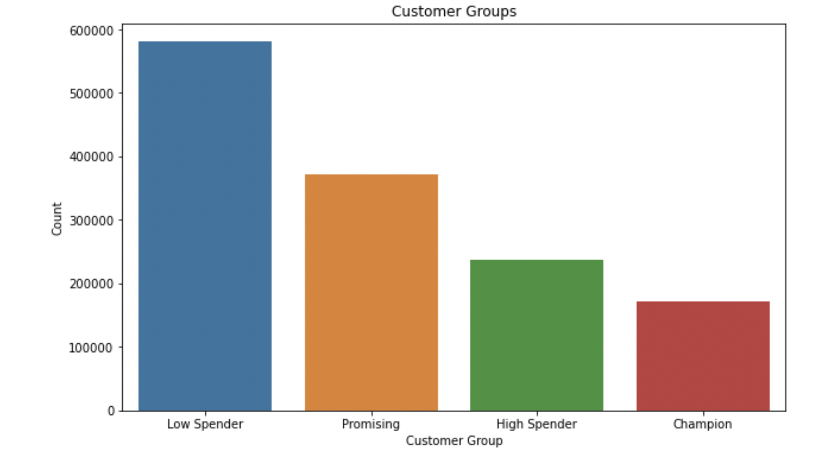
RFM Visualization
Notes:
This is another bar chart to visualize our distribution of customer segments. From the dataset, we can see that we have the most number of lower spenders, followed by promising, high spender and champion. Hence it leads to the needs to create a recommender system to re-engaged Dormant customers and boost new sales by recommender system as now we know consumer behavior and expenditure pattern

Slide 21
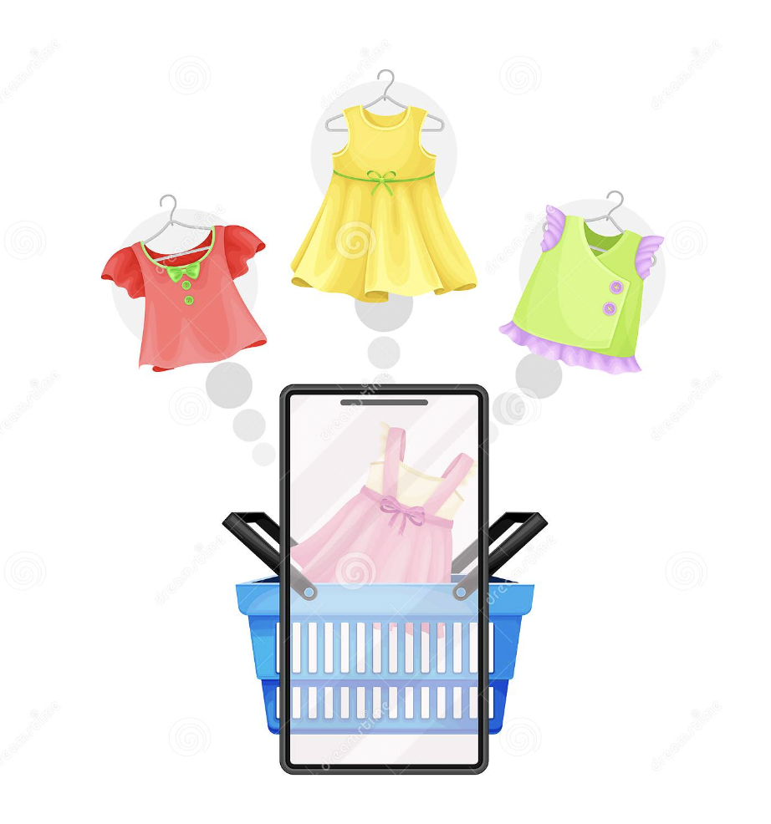
MARKET BASKET ANALYSIS
Notes:
Thank you Yin Hang! We'll now cover the section on the market basket analysis.

Slide 22
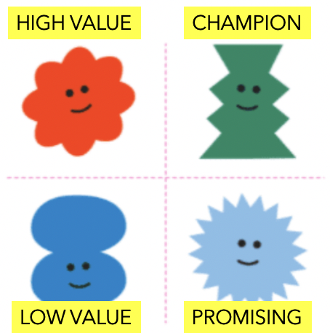



Market Basket Analysis
Apriori Algorithm
RFM
Association
Rules
Input Customers
Identify Segment
Frequent Itemset
Identify Top Articles
Notes:
The Market Basket Analysis is a statistical technique used to identify patterns of co-occurrence of items in transactions. It is mostly used by retailers to gain insights into the buying behavior of customers and make informed decisions about product placement and marketing strategies.
The Apriori algorithm is a popular algorithm used to perform Market Basket Analysis. It works by first identifying all the frequent itemsets in the dataset and then generating association rules that capture the relationship between the items in the frequent itemsets. Frequent itemsets are sets of items that occur together in a significant number of transactions.
To apply the Apriori algorithm, we start by converting the transactional data into a one-hot encoded format, where each row represents a customer, and each column represents an item. Each cell is filled with either 1 or 0, indicating whether or not the item is bought by the customer.
Next, we calculate the support of each itemset, which is defined as the proportion of transactions that contain the itemset. We then generate a list of frequent itemsets by selecting only those itemsets that have a support greater than a specified minimum support threshold.
Once we have identified the frequent itemsets, we can generate association rules that capture the relationship between the items in the frequent itemsets. An association rule is a statement of the form "if A, then B", where A and B are sets of items. The strength of an association rule is typically measured in terms of two metrics: support and confidence. Support is the proportion of transactions that contain both A and B, while confidence is the proportion of transactions that contain B given that they also contain A.
Finally, we can filter the association rules based on a minimum threshold for support and confidence to identify the most interesting and actionable rules.
In our code, we have implemented the Apriori algorithm using the mlxtend library in Python to perform market basket analysis on transactional data for different customer groups. We then visualize the results using a heatmap and also identify the top-selling products for each customer group.

Slide 23
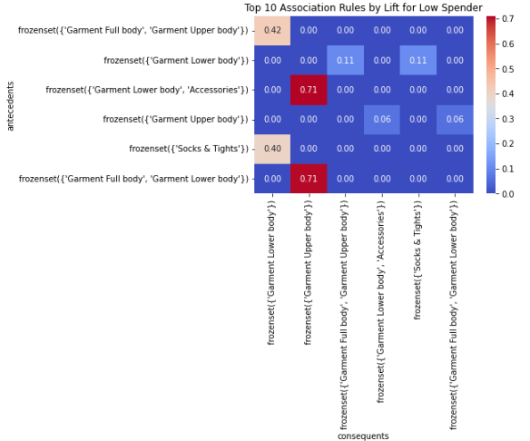
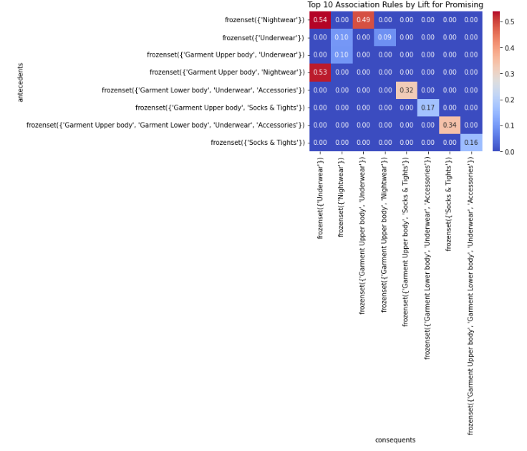
Low Spender
Promising
MARKET BASKET Visualization
Notes:
Sorting by lift, support and confidence, pivoting by support our heat map shows a confidence of 0.71 for the low spender which means that given a transaction containing the antecedent item(s), there is a 71% chance that the consequent item(s) will also be bought by the same customer. In other words, the rule "if A, then B" has a confidence of 0.71, indicating a strong association between A and B. a confidence of 0.53 for the promising means that given a transaction containing the antecedent item(s), there is a 53% chance that the consequent item(s) will also be bought by the same customer.

Slide 24
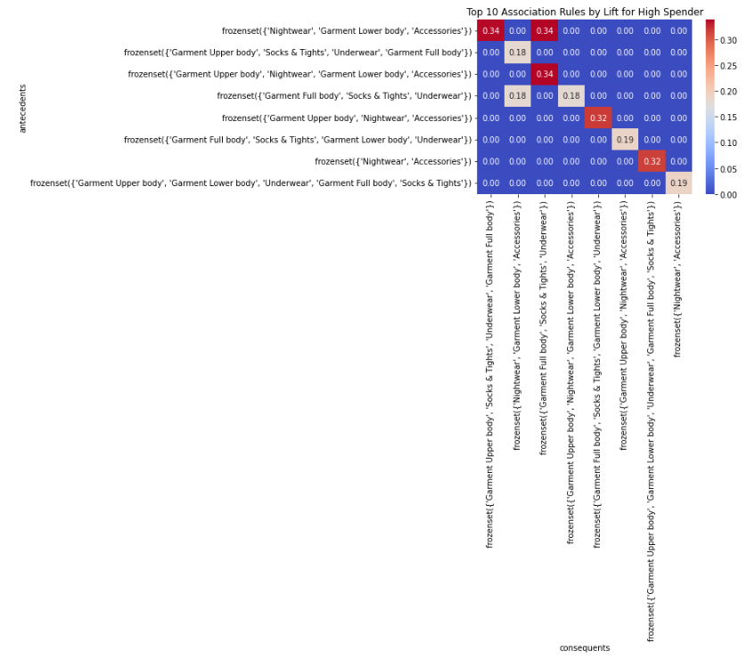
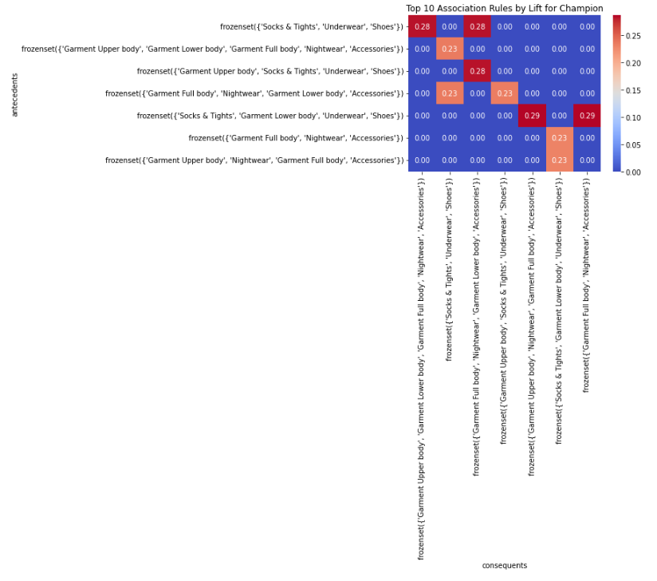
High Spender
Champion
MARKET BASKET Visualization
Notes:
a confidence of 0.34 for the low spender means that given a transaction containing the antecedent item(s), there is a 34% chance that the consequent item(s) will also be bought by the same customer. In other words, the rule "if A, then B" has a confidence of 0.34, indicating a strong association between A and B. a confidence of 0.28 for the promising means that given a transaction containing the antecedent item(s), there is a 28% chance that the consequent item(s) will also be bought by the same customer. which could suggest that these 2 segments are varied purchasers with little correlation in what they buy

Slide 25

Recommendation system
Notes:
Given the RFM as well as the market basket analysis we have designed a reccomendation system, to suggest items to a customer based on their segment

Slide 26



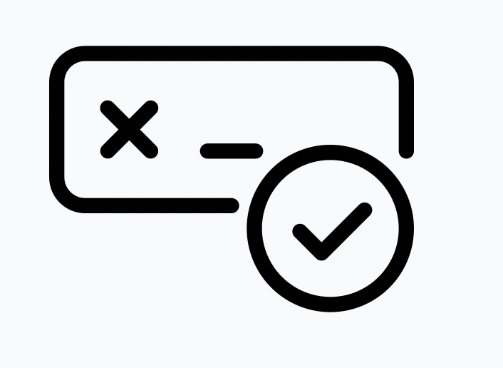
Recommendation System
Is it the first item in the cart?
Recommend based on
antecedents
Y
N
Recommend based on
consequents
invalid
Prompt to
Ask for correct input
Notes:
To perform a recommendation for a customer, we first need to determine their segment based on the RFM analysis. Once we have determined the customer's segment, we can use market basket analysis to identify items that are frequently purchased together by customers in that segment. We can then use these frequent itemsets to make recommendations for the customer based on their current basket. This market_basket function does this through the use of the APriori algorithm. Showing antecedents and consequents keywords inside the market_basket function to identify frequent itemsets and association rules. Then, use the resulting data to make product recommendations to customers based on their segment and the items in their basket. The rules of which represent sets of items that tend to be purchased together by customers within each segment. we'll now show a demonstration of how the market basket analysis works In our first scenario. We'll take the persona of a customer, under the Promising segment and with 2 items in basket and champion with two products in cart.
and lastly we'll show a persona where a customer might be new to H&M's business or simply has not made any purchases within the last two years

Slide 27

Data governance
Notes:
Today, I'll be presenting using the RFM (Recency, Frequency, Monetary) analysis to segment customers.
RFM analysis is a marketing technique used to analyze customer behavior and divide them into different segments based on their buying patterns.
In order to better understand our customers, we will use RFM analysis to segment the customer base

Slide 28
LIMITATIONS
Customer Segmentation
Current customer segments may not be representing entire customer population
For example, the scope of work does not include no transaction customers for now

Slide 29
DATA GOVERNANCE
Privacy
Data Quality
Data Accessibility
Bias
Compliance
Notes:
There are several potential data governance issues that we need to look into:
Firstly, Privacy: The transaction data may contain personally information. If this data is not properly secured, it could lead to breaches of privacy and other legal consequences.
Secondly, data quality: The transaction data needs to be of high quality to ensure accurate results.
For data accessibility, the access to the transaction data needs to be restricted to only authorized personnel who have a legitimate business need for it. This can help prevent unauthorized access, misuse, or theft of the data.
There may be bias in the data, such as certain demographics being overrepresented or underrepresented. This could lead to biased results from the RFM analysis and the recommender system.
Lastly, Compliance: There are several data governance laws to be followed, such as Personal Data Protection Act (PDPA) and Personal Data Protection Commission (PDPC) Guidelines. Non-compliance with these laws and regulations could result in legal and financial consequences for the company.
It is important for H&M to ensure that proper data governance measures are in place to address these issues and ensure the responsible and ethical use of customer transaction data

Slide 30
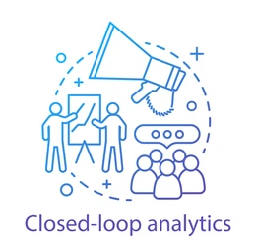
DATA PROVENANCE
RFM analysis
Market basket analysis
Recommender
Collect new data after recommender campaign
Data
Notes:
To ensure the effectiveness of the recommendation system, H&M needs to collect feedback from customers and analyze new data. By monitoring the system's performance, H&M can identify areas for improvement and make changes to the system over time. For example, the company can analyze which recommendations customers are clicking on and purchasing and use this information to adjust the system to improve the accuracy of future recommendations.
Continuous improvement of the recommendation system is essential to keep up with changing customer preferences and trends. By consistently evaluating and improving the system, H&M can maintain its competitive position in the market, enhance customer satisfaction, and drive business growth.

Slide 31
CONCLUSION
Understand customer behaviour by RFM analysis
Understand purchase pattern and preference by Market Basket Analysis
Build a Recommender system to:
Increase sales
Drive growth
Target customers more effectively
Collect data after the recommender system for close-loop analysis

Slide 32

Collaborative
Filtering
Content-based
Filtering
Uses past interactions between customers and articles to produce recommendation
Example: Existing customers recommend similar articles
Uses article features to recommend other similar articles to customer preference (based on previous transaction)

Slide 33
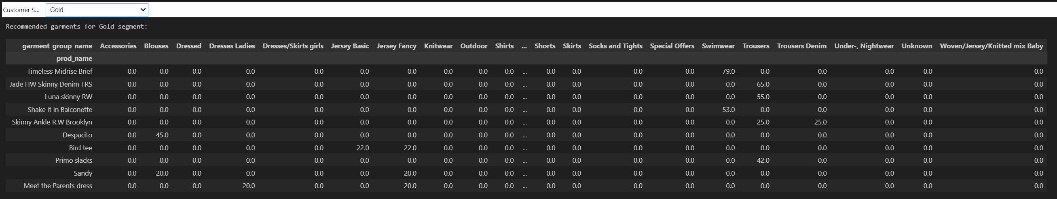
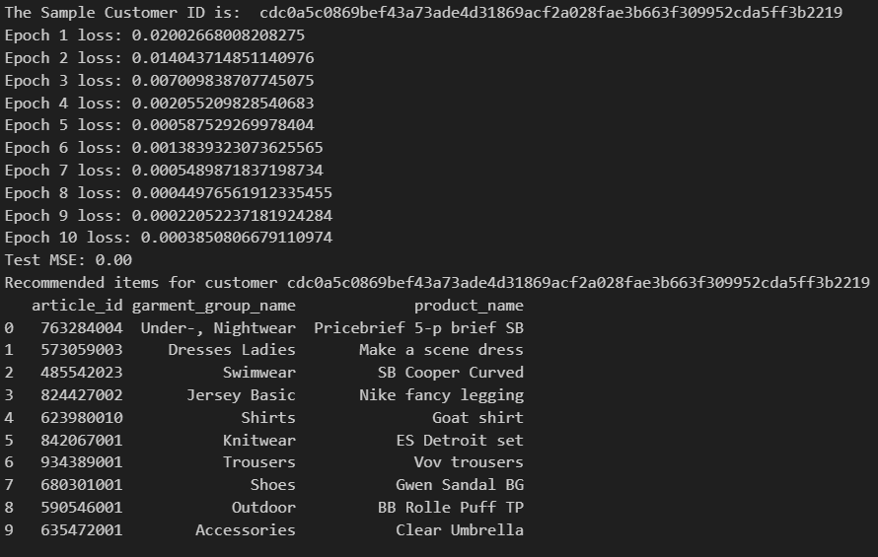
Recommender System
Two ways of performing recommendations
By segment
By customer
Notes:
We took a two pronged approach when creating the recommender system. Firstly, we based

Slide 34
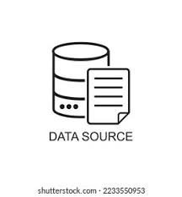
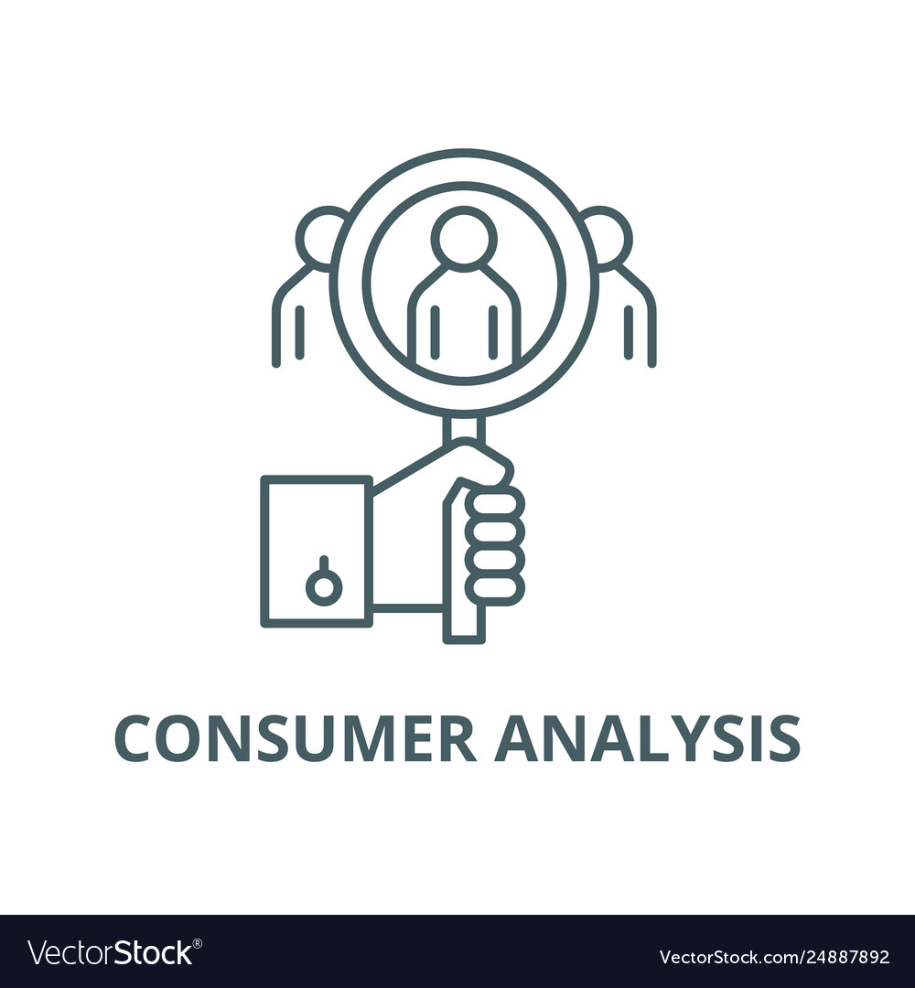
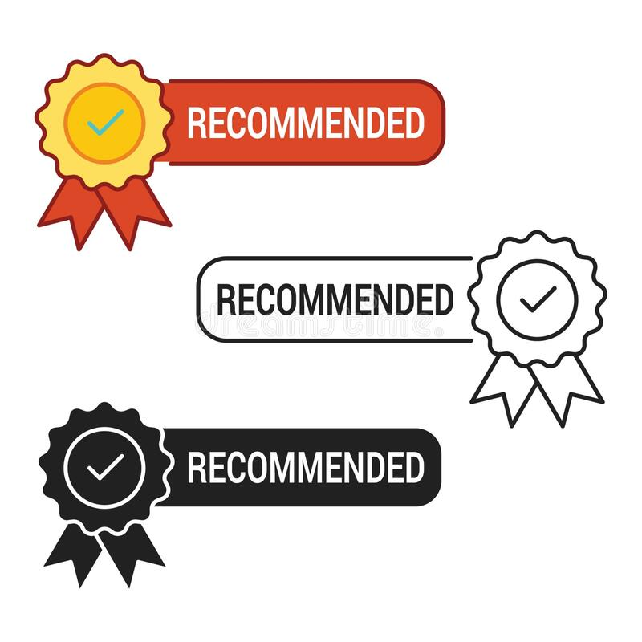
Data and Methodologies
H&M purchase history of customers across time data from kaggle.com:
- Articles (article ID, product name, product group section name, product patterns, product colors, index group)
- Customer (customer ID, Member status, news frequency, age)
- Transaction Train (date, customer ID, article ID, price, sales channel ID)
-Customer clustering involves grouping customers into different segments based on their buying behaviour.
-Using various analysis methods, such as analysis of variance (ANOVA) and regression analysis to analyze the relationship between the customer’s behavior and willingness to buy certain H&M products.
-RFM analysis is used to segment customers. Based on how recently an H&M customer has made a purchase, how often the customer makes purchases, and how much on average per purchase.
-Using association rule mining, or market basket analysis, to identify which products are frequently purchased together and use this information to make product recommendations based on customer purchases.
-Leverage collaborative analysis or content-based analysis to identify patterns in their purchasing habits and preferences.

Slide 35

Address the Bias in Modeling
Sampling bias
Cherry-picking effect
Hawthorne effect
McNamara fallacy
Overfitting
Notes:
In this project, sampling bias are introduced to the model when the data used to train the recommendation system is not diverse enough. Also, bias is introduced if the recommendation system only suggests certain types of clothing or colours because they have been popular in the past, without considering that customer preferences may have changed over time. In other hands, if a customer intentionally browses certain products or clicks on certain links to influence the recommendations they receive. Inaccurate and unreliable recommendations may not reflect the actual preferences and behaviours of customers. Due to the limitation of the data set , the recommendation system relies solely on quantitative data, such as past purchase history and clickstream data, and ignores qualitative factors, such as customer feedback and preferences. It will lead the recommendation system to suggest specific products based solely on past purchases, without considering other factors such as customer feedback on the product's fit, style, or quality. suppose the recommendation system is trained on data that includes only popular products among certain customer groups, the overfitting will happen.

Slide 36
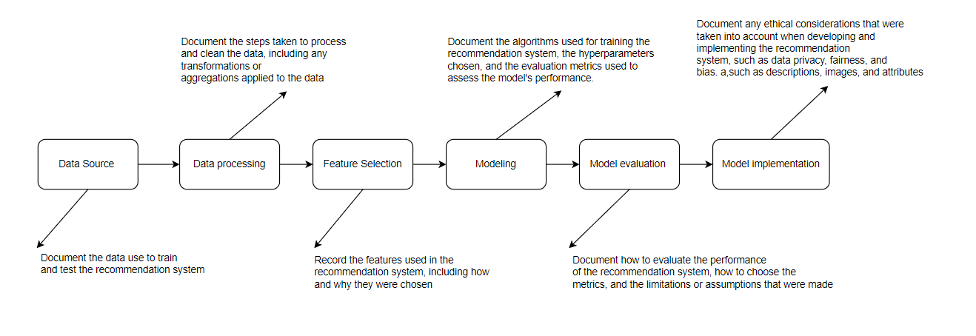
Data Governance
Ensure Trustworthiness
Increase Customer Loyalty
Improve Accountability
Comply with Ethical Standards and Regulations
Notes:
Data Provenance is an essential part of data governance by documenting its data management processes and policies. It helps the Organization in following aspects:
In this project, the data provenance is following below steps:

Slide 37
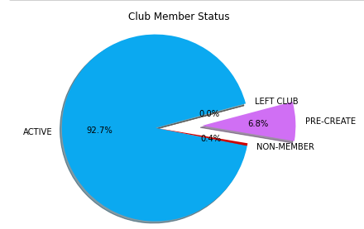
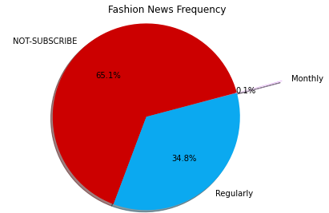
Data Exploration: Customer Dataset
Customer dataset includes customer detailed information such as customer ID, member status, news frequency, age
Notes:
Around 92% customers have active membership with H&M, but only 35% of them subscribe to the fashion new.

Slide 38
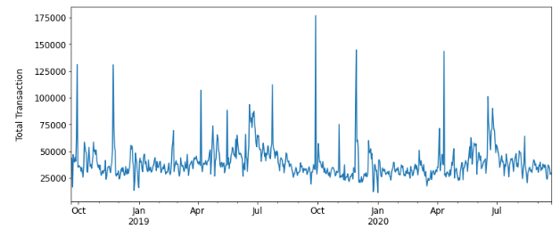
Data Exploration: Transaction Dataset
Notes:
Jan, Feb, Mar is the lowest transactions consistently across 2019 and 2020
May, June July is the highest across 2019 and 2020
We want to do our recommender campaign during the non-peak season to boost the sales,Jane Feb Mar
Over 2 years, the sales do not seem to increase, so need to have new strategies to improve sales

Slide 39
Market Basket Visualization
Notes:
In this visualization, we are using the Apriori algorithm to generate frequent itemsets and association rules for each of the customer groups in our dataset. For each group, we are selecting the top 10 association rules by lift, which indicates the strength of the relationship between the antecedents and consequents in each rule.
We are then visualizing the frequency of co-occurrence of products in these top association rules using a heatmap. The heatmap shows the frequency of each combination of products in the antecedents and consequents of the association rules. The darker the color, the more frequently those products occur together in the same transaction.
For the low spenders group, we can see that the antecedents and consequents intersect at a value of 0.04. This means that items in the antecedents and consequents occur together in 4% of transactions for this group. Similarly, for the promising group, the intersection is also at 0.04

Slide 40
Market Basket Visualization
Notes:
For the high spenders group, the intersection is at 0.03, indicating a stronger relationship between items in the antecedents and consequents. Finally, for the champion group, the intersection is also at 0.04, indicating a similar level of association as the low spenders and promising groups.

